Slide 1
PLACES WHERE WE CAN FOUND EQUALITY

Slide 2
PRESENTED BY RIDDHONIL

Slide 3
Place where we get equality.
Law and order
Right of citizen
Hospital
School, college, university
Grocery shop
Parlour
Restaurant
Wasa
Super shop
Desco
Roads and Highways
Park
Sea beach
School’s play ground

Slide 4
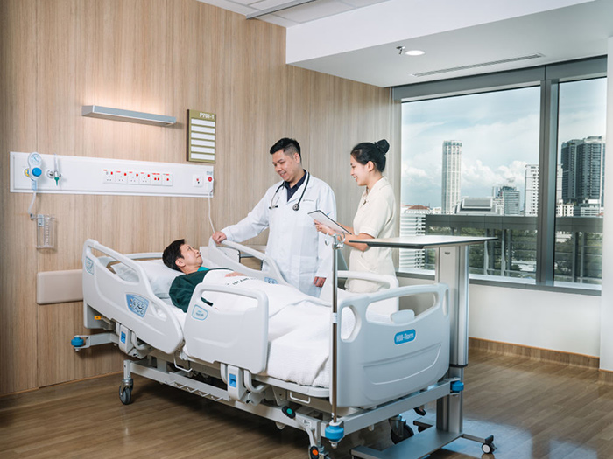
Hospital
We can get equality in hospital. Because doctors, nurses and all staffs of hospital give their care equally to the patient.

Slide 5
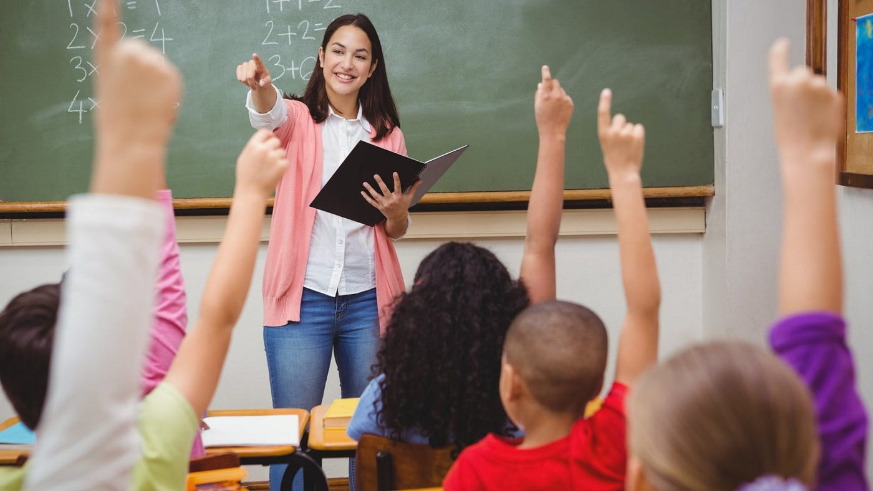
School, College, University
Students get education equally from school, cause teachers tech them equally.

Slide 6
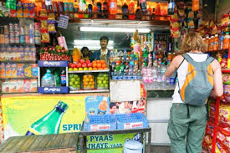
Grocery shop
People can buy the product equally from a grocery shop

Slide 7
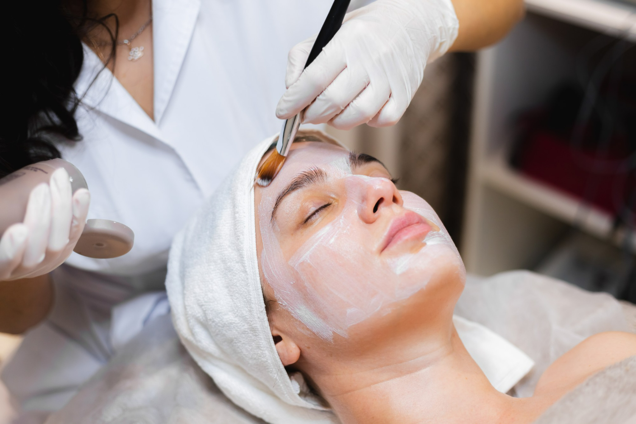
Parlour
In parlour we get equally service cause the barber cuts the hair of every one.

Slide 8
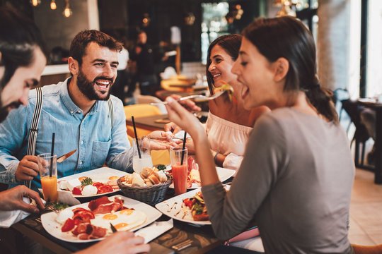
Restaurant
People get equally service of food in restaurant.

Slide 9

WASA [Dhaka Water Supply And Sewerage Authority]
All the citizen of Dhaka gate equal service from WASA

Slide 10

DESCO
DESCO gives electric supply to all of the citizen of Dhaka equally

Slide 11
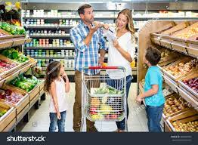
SUPER SHOP
Everybody get the same facilities from super shop

Slide 12
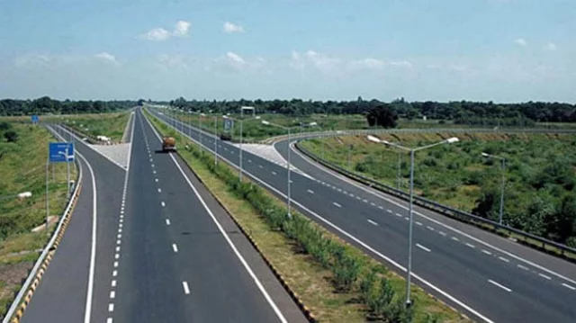
Roads and Highways
People can enjoy all the govt. Roads and Highway equally.

